Slide 1
Child with limping
Sachith Mettananda
Department of Paediatrics
2018
Notes:
Ladies and Gentlemen, It is indeed a great pleasure to talk to you today on a very novel approach to cure thalassaemia as a tribute to the very first academic who described the disease in Sri Lankan Children.

Slide 2
Development of gait
< 2 yrs - wide based, rapid short steps
2 yrs - increased velocity & step length
3 yrs - most similar to adult gait
7 yrs - adult gait

Slide 3
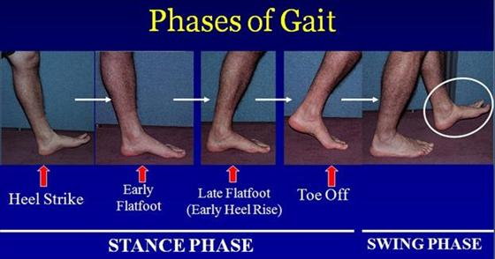
Normal gait

Slide 4
Assessment of limping
Painful (antalgic)
Short stance phase on painful limb
Trauma
Infection
Inflammation
Neoplasms
Painless (Trendelenburg)
Stance phase equal in both limbs
Congenital
Developmental
NM disorders

Slide 5
Differential diagnosis of limping
Toddler (1-3 yrs)
Infections (Septic arthritis / Osteomyelitis)
Trauma / NAI
DDH
NM disorders
Neoplasms

Slide 6
Differential diagnosis of limping (cont.)
Child (4-10 yrs)
Transient synovitis
Perthes disease
Infections (Septic arthritis / Osteomyelitis)
JIA
Trauma / Mechanical
Neoplasms

Slide 7
Differential diagnosis of limping (cont.)
Adolescent (11-16 yrs)
Slipped Capital Femoral Epiphysis
JIA
Trauma
Mechanical
Neoplasms

Slide 8
Septic Arthritis

Slide 9
Common among young children
Specially < 2 yrs
M: F = 2 :1
Majority are of haematogenous origin

Slide 10
Etiology
Staph. aureus
H. influenzae type b
Group A streptococcus
Strep. pneumoniae
Group B streptococcus (in neonates)
E. coli (in neonates)

Slide 11
Clinical features
Signs of arthritis
Swelling, Erythema, Warmth, Tenderness, Loss of function
Usually monoarthritis involving KJ/ HJ/ AJ
75% lower limb; 25% upper limb
Small joints – very rarely affected
Older children – Fever, Pain, Limping
Neonates – Subtle features, Reduced movement in limb

Slide 12
Investigations
FBC – neutrophil leukocytosis
ESR / CRP – raised
Blood culture
Joint aspirate for culture and ABST
X-ray – Not very helpful; widening of joint space
US Scan – joint effusion
MRI – helpful to exclude adjacent osteomyelitis

Slide 13
Treatment
Supportive
Bed rest
Splint
Hydration
Symptomatic
Analgesics

Slide 14
Treatment (cont.)
Specific
Arthrotomy
Antibiotics
Neonate – cefotaxime + flucloxacillin
Children – cefuroxime/cefotaxime ± flucloxacillin
Second line (in CA-MRSA)- Clindamycin/ vancomycin
Duration – Depends organism
IV Ab until afebrile for 48-72 hours and clinically improving
Total duration- long; usually weeks
Prevention of complications
physiotherapy

Slide 15
Transient synovitis/ Toxic synovitis

Slide 16
Usually involves the hip joint
Common between 3 – 8 yrs
Cause - uncertain
? Viral infection
? Allergic hypersensitivity

Slide 17
Clinical features
Preceding URTI (7-14 before the onset of symptoms) – in a majority
Pain – groin / thigh / knee
Can bear weight (usually)
Antalgic limp
Low grade fever
ROM – no marked reduction

Slide 18
Investigations
ESR – normal / slight elevation
CRP/FBC –Normal
X ray
B/L Hip joints AP - Normal
Frog leg lateral - Normal
US hip – joint effusion
Other investigations usually normal

Slide 19
Treatment
Treatment is Conservative
Bed rest until pain resolves
Analgesics – Paracetamol /NSAIDS
Prognosis
Most recover within 3-6 weeks

Slide 20
Perthes disease (Legg-Calvé-Perthes disease)

Slide 21
Idiopathic avascular necrosis of the capital femoral epiphysis – due to interrupted blood supply
Cause - unknown
M:F = 4-5 : 1
Age of onset 2-12 years (Peak 4-8 years)
Bilateral in 10%
Incidence in whites > asians

Slide 22
Pathogenesis
4 stages
Initial stage (6 months) - synovitis, joint irritability, and early necrosis - osteoclastic-mediated resorption of the necrotic segment - necrotic bone is replaced by fibrovascular tissue
Fragmentation stage (8 months) – collapse of femoral epiphysis which begins to extrude from the acetabulum
Healing stage (4 years) - Reossification begins centrally and expands in all directions.
Residual stage (until skeletal maturity) - after the entire head has reossified. Remodeling of the femoral head

Slide 23
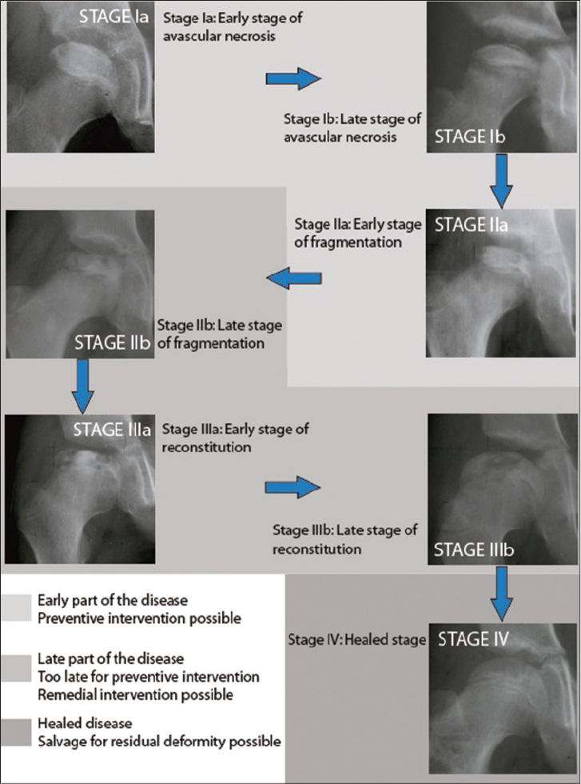

Slide 24
Clinical features
Mild intermittent pain in anterior thigh
Limp – painless / painful
ROM – reduced (sp. Internal rotation / abduction)
Atrophy of thigh muscles

Slide 25
Investigations
X-ray pelvis AP & frog leg lateral view
Cessation of CFE growth
Subchondral fractures
Bone resorption (fragmentation)
Reossification
Healed / residual stage

Slide 26
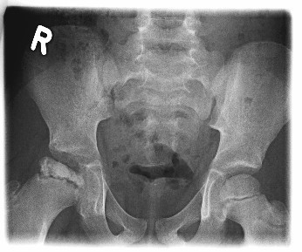

Slide 27
Complications
Osteoarthritis
Onset < 5yrs – negligible risk
Onset 6-10 yrs – 38%
Onset >10 yrs – 100%
Poor prognostic factors
Older age at onset
Extensive CFE involvement
Loss of femoral head containment
Reduced ROM
Premature CFE closure

Slide 28
Treatment
Self healing disorder
then why treatment ?
Aims of treatment
Eliminate hip irritability
Restoration of ROM
Prevention of CFE collapse
Attainment of a spherical femoral head at healing

Slide 29
Treatment (cont.)
Concept –containment of femoral head within the acetabulum
Age < 6 yrs – Expectant observation
Age > 6 yrs – needs containment
Non-surgical – casts/ orthosis
Surgical – femoral / pelvic osteotomy

Slide 30
Slipped Capital Femoral Epiphysis

Slide 31
Cause – unknown
Common in obese / tall adolescents

Slide 32
Clinical features
Pain on hip motion / KJ pain
Antalgic limp
ROM – reduced internal rotation, flexion, abduction

Slide 33
Investigations
X-ray pelvis AP and frog leg lateral view
A line superimposed on the superior border of the femoral neck does not intersect the femoral head

Slide 34
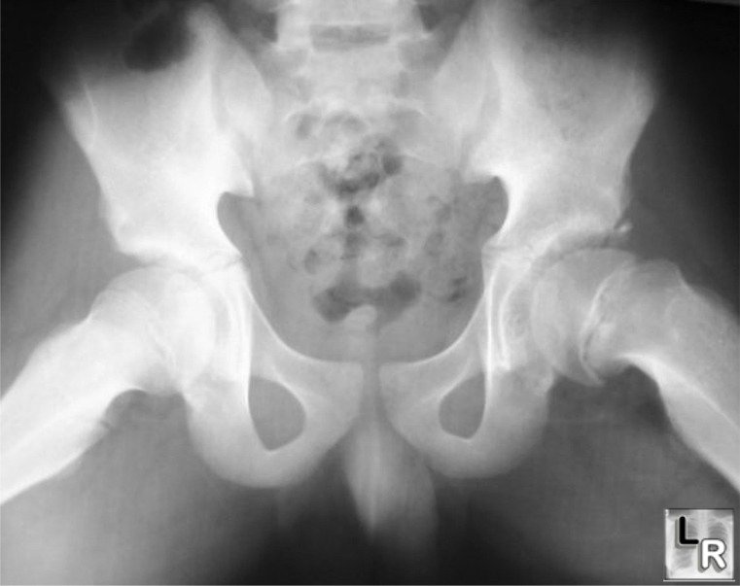

Slide 35
Complications
Avascular necrosis
Chondrolysis

Slide 36
Treatment
Goals
Prevent further slippage and minimize complications
Epiphysiodesis
Surgical pinning with screws

Slide 37
Summary…

